Slide 1
Data Collection and Cleaning Steps
Pulled out the data from ModuleShippingData (TDS) table in SQLdatabase for the time from 04/2016 to present.
a. we have 27038 units
b. 13,276 units (including 195 failed units) missing SMSR
c. 1,885 units (including 28 failed units) missing SMSR2
2) Pulled out SMSR data from ModuleFailSMSR table in SQL database for the unit selected previoulsly
result:
a. 1 passed unit missing SMSR
b. 576 units (including 14 failed units) missing SMSR2
3) Deleted that 1 unit from the analysis
4) Used SMSR2_Iop from 1752_C21_QMA_228 file to replace with missing SMSR2 values for failed units
result:
a. 562 passed units missing SMSR2 values
5) Deleted 562 passed units from the analysis
6) Deleted some few passed units with SMSR of 0.00 as well as SMSR<30 .
Result: 26240 Units including 227
Features =
'TDS_DT', 'Device_SN', 'Description', 'PartNo_Select', 'Ith', 'Slopeff', 'Chirp', 'WaveLen', 'SMSR', 'CSO', 'CTB', 'MPDCurrent', 'TrackingError_Max', 'TrackingError_Min', 'ForwardVoltage', 'FreqResponse', 'ChirpParameter', 'LsrTemperature', 'Iop', 'CNR_61', 'CNR_547', 'Station', 'Operator', 'B_Const_K', 'RTH_Kohm', 'CNR_294', 'SMSR2', 'Pass_test'

Slide 2
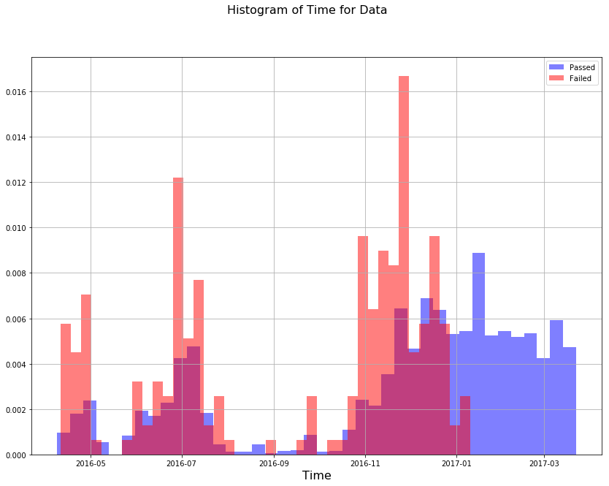
Looking at Passed/Failed Units in Time
Total number of units → 26460
Number of failed units → 227
63% of data belongs to the time before 2017-01-15. → 16784 units
37% belongs to after 2017-01-15. → 9676 units

Slide 3
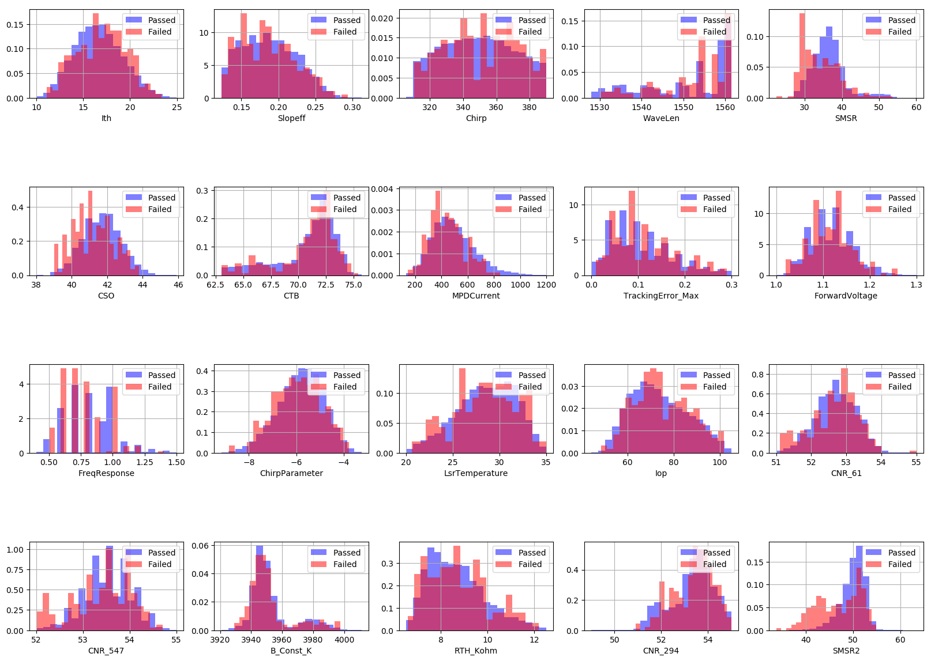
Histograms of Different Features

Slide 4
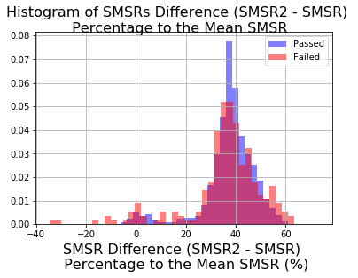
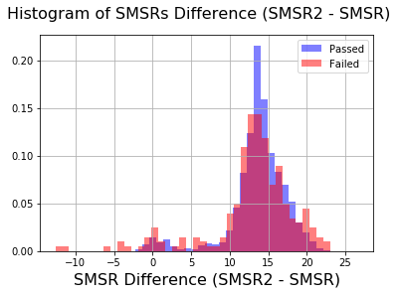
SMSR2 and SMSR Difference
Mean of the SMSR difference = 37.59 %
Mean of the SMSR difference = 13.66

Slide 5
Correlation Between Different Features
ChirpParameter
-0.98
-0.43
-0.78
Ith
Iop
Slopeff
Forward
Voltage
0.45
-0.96
0.78
0.59
0.61
SMSR2
SMSR
CNR_547
CNR_61
CNR_294
0.49
0.68

Slide 6
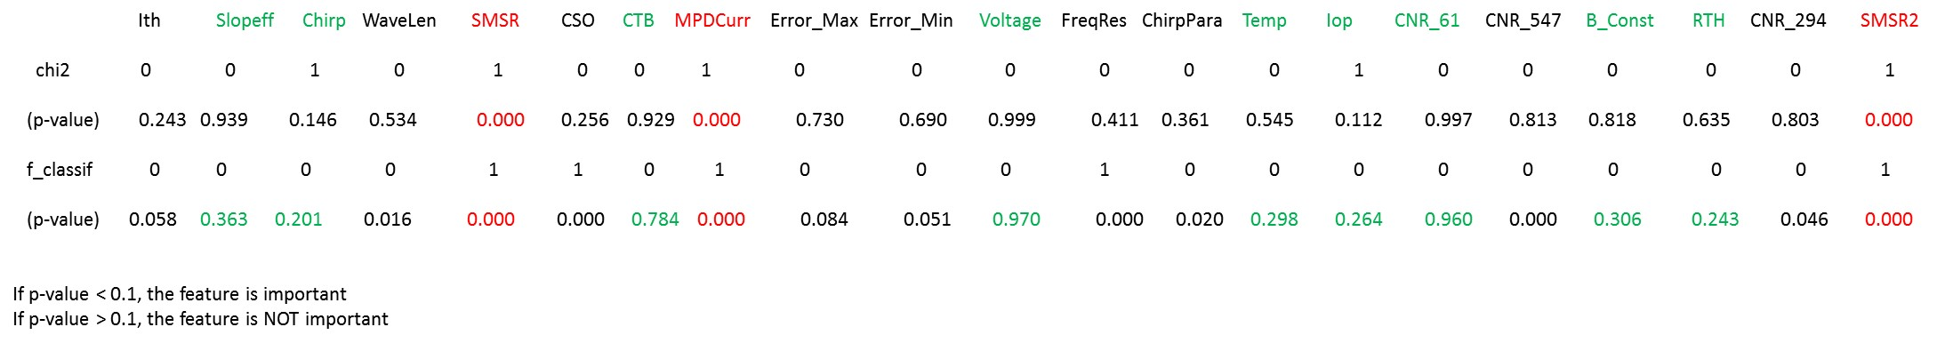
Hypothesis Test on Feature Importance
Based on the linear dependency test (F-test) and total dependency test (chi2), we get the following conclusions:
The following features are important to predict the failed units.
  SMSR, SMSR2, MPDCurrent
The following features are not important with a very high probability:
  ForwardVoltage, CNR-61, CTB, Slopeff, B_const_K, LaserTemprature, RTH_Kohm, Chirp, Iop

Slide 7
Machine Learning Model on Feature Importance
Feature | Feature Importance Value
SMSR2 | 0.217
SMSR | 0.107
CSO | 0.0628
MPDCurrent | 0.0496
CNR_547 | 0.0448
WaveLen | 0.0435
B_Const_K | 0.0428
Slopeff | 0.039
ChirpParameter | 0.0377
Chirp | 0.037
RTH_Kohm | 0.03607
Ith | 0.035
Iop | 0.035
CTB | 0.0342
CNR_294 | 0.03251
LsrTemperature | 0.0317
CNR_61 | 0.0294
TrackingError_Min | 0.024
TrackingError_Max | 0.0232
ForwardVoltage | 0.0197
FreqResponse | 0.015
Features Used :
[]
Importance Values :
[0.035, 0.039, 0.037, 0.0435, 0.107, 0.0628, 0.0342, 0.0496, 0.0232, 0.024, 0.0197, 0.015, 0.0377, 0.0317, 0.035, 0.0294, 0.0448, 0.0428, 0.03607, 0.03251, 0.2170]

Slide 8
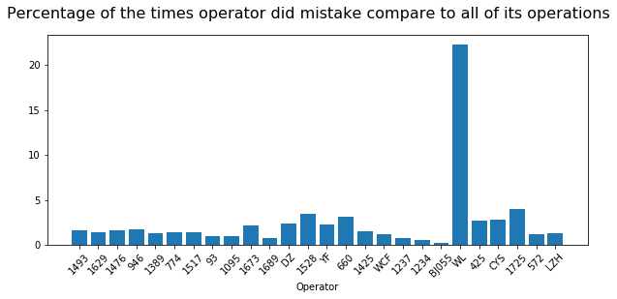
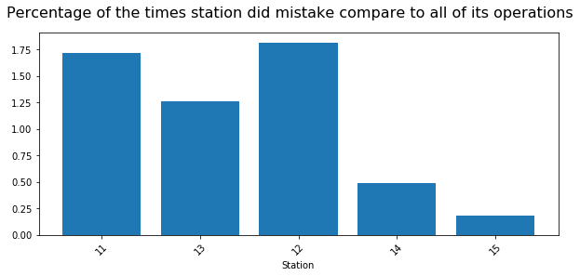
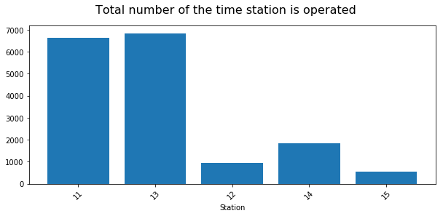
Operator and Station Performance
Total number of operations = 9

Slide 9
Clustering Results
Total Failure Percentage = 1.35%
7 Clusters
cluster 0: number of passed = 3829, number of failed = 52, failure Percentage = 1.33 %
cluster 1: number of passed = 1416, number of failed = 9, failure Percentage = 0.63 %
cluster 2: number of passed = 1779, number of failed = 32, failure Percentage = 1.76 %
cluster 3: number of passed = 2353, number of failed = 25, failure Percentage = 1.051 %
cluster 4: number of passed = 3409, number of failed = 67, failure Percentage = 1.92 %
cluster 5: number of passed = 3307, number of failed = 41, failure Percentage = 1.22 %
cluster 6: number of passed = 464, number of failed = 1, failure Percentage = 0.21 %
Feature | Cluster 0 Center | Cluster 1 Center | Cluster 2 Center | Cluster 3 Center | Cluster 4 Center | Cluster 5 Center | Cluster 6 Center
Ith | 16.4889 | 16.9636 | 16.6871 | 16.8120 | 16.4407 | 16.6787 | 17.4271
Slopeff | 0.1913 | 0.1662 | 0.2101 | 0.1733 | 0.2011 | 0.1812 | 0.1513
Chirp | 348.9523 | 351.2543 | 347.2012 | 350.8093 | 347.9272 | 350.0452 | 353.1782
WaveLen | 1551.4352 | 1550.5321 | 1549.4805 | 1552.0674 | 1550.4798 | 1552.2901 | 1548.7656
SMSR | 36.3532 | 36.5203 | 36.3131 | 36.5068 | 36.3154 | 36.1695 | 36.2672
CSO | 41.6607 | 41.6824 | 41.7054 | 41.6603 | 41.7067 | 41.6419 | 41.5770
CTB | 71.1294 | 69.8380 | 70.6632 | 70.4553 | 70.9949 | 70.9074 | 69.5170
MPDCurrent | 446.4344 | 752.6545 | 260.8967 | 631.5508 | 359.9608 | 533.5774 | 939.8961
TrackingError_Max | 0.1063 | 0.1051 | 0.1076 | 0.1043 | 0.1068 | 0.1050 | 0.1030
TrackingError_Min | -0.1363 | -0.1276 | -0.1393 | -0.1308 | -0.1364 | -0.1308 | -0.1249
ForwardVoltage | 1.1111 | 1.1378 | 1.1042 | 1.1281 | 1.1055 | 1.1185 | 1.1590
FreqResponse | 0.8230 | 0.8449 | 0.8114 | 0.8317 | 0.8105 | 0.8228 | 0.8332
ChirpParameter | -5.7532 | -5.9522 | -5.7958 | -5.8928 | -5.7217 | -5.8365 | -6.1477
LsrTemperature | 28.5263 | 28.7000 | 28.4903 | 28.6223 | 28.5181 | 28.4745 | 28.9712
Iop | 72.3498 | 81.0401 | 67.5282 | 78.4884 | 69.4624 | 75.6821 | 86.8689
CNR_61 | 52.6786 | 52.5465 | 52.7125 | 52.5963 | 52.6982 | 52.6523 | 52.5275
CNR_547 | 53.5169 | 53.5099 | 53.4371 | 53.5321 | 53.4920 | 53.5367 | 53.4959
B_Const_K | 3952.4483 | 3953.1559 | 3953.0188 | 3952.6992 | 3952.5707 | 3952.6205 | 3953.8049
RTH_Kohm | 8.6773 | 8.6152 | 8.6905 | 8.6486 | 8.6797 | 8.7050 | 8.5172
CNR_294 | 53.2839 | 53.1983 | 53.3053 | 53.2172 | 53.3082 | 53.2634 | 53.1553
SMSR2 | 50.1081 | 49.7347 | 49.8497 | 50.1335 | 49.9581 | 50.1031 | 49.3607

Slide 10
Clustering Results
Total Failure Percentage = 1.35%
5 Clusters
cluster 0: number of passed = 4636, number of failed = 54, failure percentage=1.15%
cluster 1: number of passed = 2799, number of failed = 31, failure percentage=1.09%
cluster 2: number of passed = 5085, number of failed = 81, failure percentage=1.56%
cluster 3: number of passed = 3119, number of failed = 58, failure percentage=1.82%
cluster 4: number of passed = 918, number of failed = 3, failure percentage=0.32%
Feature | Cluster 0 Center | Cluster 1 Center | Cluster 2 Center | Cluster 3 Center | Cluster 4 Center
Ith | 16.8770 | 16.4581 | 16.5770 | 17.2455 | 16.6573
Slopeff | 0.1710 | 0.1950 | 0.2080 | 0.1572 | 0.1815
Chirp | 350.6427 | 348.8953 | 347.0892 | 352.2548 | 350.0098
WaveLen | 1551.5077 | 1551.2385 | 1549.5798 | 1549.5578 | 1552.1613
SMSR | 36.5051 | 36.2974 | 36.3515 | 36.2972 | 36.2806
CSO | 41.6745 | 41.6590 | 41.7380 | 41.6195 | 41.6460
CTB | 70.2371 | 71.1056 | 70.7497 | 69.5880 | 70.9224
MPDCurrent | 671.6267 | 412.8299 | 291.5162 | 873.2208 | 530.6565
TrackingError_Max | 0.1052 | 0.1063 | 0.1072 | 0.1013 | 0.1056
TrackingError_Min | -0.1303 | -0.1364 | -0.1383 | -0.1250 | -0.1314
ForwardVoltage | 1.1315 | 1.1087 | 1.1039 | 1.1510 | 1.1185
FreqResponse | 0.8342 | 0.8175 | 0.8123 | 0.8454 | 0.8233
ChirpParameter | -5.9127 | -5.7419 | -5.7564 | -6.0684 | -5.8281
LsrTemperature | 28.6507 | 28.5112 | 28.5428 | 28.9234 | 28.4672
Iop | 79.3869 | 71.2090 | 67.8980 | 84.4741 | 75.5538
CNR_61 | 52.5826 | 52.6918 | 52.7025 | 52.5163 | 52.6497
CNR_547 | 53.5207 | 53.5121 | 53.4546 | 53.5001 | 53.5337
B_Const_K | 3952.9208 | 3952.4797 | 3952.9662 | 3953.5547 | 3952.4710
RTH_Kohm | 8.6393 | 8.6828 | 8.6689 | 8.5281 | 8.7065
CNR_294 | 53.2184 | 53.2952 | 53.3127 | 53.1420 | 53.2585
SMSR2 | 49.9855 | 50.0374 | 49.8851 | 49.4756 | 50.1461

Slide 11
Clustering Results
Total Failure Percentage = 1.35%
3 Clusters
cluster 0: number of passed = 7052, number of failed = 96, failure percentage=1.65%
cluster 1: number of passed = 2835, number of failed = 19, failure percentage=0.66%
cluster 2: number of passed = 6670, number of failed = 112, failure percentage=1.34%
Feature | Cluster 0 Center | Cluster 1 Center | Cluster 2 Center
Ith | 16.5165 | 16.9870 | 16.6425
Slopeff | 0.2021 | 0.1653 | 0.1827
Chirp | 348.1330 | 351.2152 | 349.7457
WaveLen | 1550.3856 | 1550.6459 | 1552.0423
SMSR | 36.3332 | 36.4670 | 36.2910
CSO | 41.6955 | 41.6651 | 41.6496
CTB | 70.9401 | 69.9199 | 70.9181
MPDCurrent | 346.5878 | 753.1221 | 525.0099
TrackingError_Max | 0.1066 | 0.1045 | 0.1056
TrackingError_Min | -0.1374 | -0.1285 | -0.1323
ForwardVoltage | 1.1059 | 1.1390 | 1.1180
FreqResponse | 0.8122 | 0.8384 | 0.8260
ChirpParameter | -5.7510 | -5.9605 | -5.8187
LsrTemperature | 28.5259 | 28.7388 | 28.4999
Iop | 69.3635 | 81.4043 | 75.2161
CNR_61 | 52.7012 | 52.5529 | 52.6497
CNR_547 | 53.4844 | 53.5119 | 53.5289
B_Const_K | 3952.6994 | 3953.1785 | 3952.5160
RTH_Kohm | 8.6761 | 8.6046 | 8.6925
CNR_294 | 53.3085 | 53.1883 | 53.2588
SMSR2 | 49.9566 | 49.7764 | 50.1289

Slide 12
Clustering Results
Total Failure Percentage = 1.35%
2 Clusters
cluster 0: number of passed = 10486, number of failed = 172, failure percentage=0.90%
cluster 1: number of passed = 6071, number of failed = 55, failure percentage=1.61%
 | Cluster 0 Center | Cluster 1 Center
Ith | 16.8565 | 16.5324
Slopeff | 0.1717 | 0.1966
Chirp | 351.0070 | 348.3946
WaveLen | 1551.5776 | 1550.8830
SMSR | 36.4152 | 36.2938
CSO | 41.6502 | 41.6825
CTB | 70.3479 | 70.9909
MPDCurrent | 660.0330 | 395.6332
TrackingError_Max | 0.1042 | 0.1067
TrackingError_Min | -0.1296 | -0.1360
ForwardVoltage | 1.1303 | 1.1089
FreqResponse | 0.8342 | 0.8158
ChirpParameter | -5.9126 | -5.7600
LsrTemperature | 28.6189 | 28.5123
Iop | 79.0892 | 70.9438
CNR_61 | 52.5958 | 52.6873
CNR_547 | 53.5275 | 53.4969
B_Const_K | 3952.8818 | 3952.6006
RTH_Kohm | 8.6500 | 8.6829
CNR_294 | 53.2202 | 53.2935
SMSR2 | 49.9966 | 50.0009

